Slide 1





MySQL Introduction
How do RDBMS work?
Intro to
MySQL & DB
SoftUni Team
Technical Trainers
Software University
http://softuni.bg

Slide 2
Questions
sli.do #PHP-WEB

Slide 3

Table of Contents
Intro
Big Picture
Databases
Data Management
Database Engine & Storage
Data Types
Database Modeling

Slide 4

Intro

Slide 5
Big Picture
HTTP
FILE
TCP/Socket
Server
Internet
DB
Browser
Web Server
PHP
DB Client

Slide 6

Database

Slide 7

Data Management
When Do We Need a Database?

Slide 8
Storage vs. Management
SALES RECEIPT
Date: 07/16/2016
Order#: [00315]
Customer: David Rivers
Product: Oil Pump
S/N: OP147-0623
Unit Price: 69.90
Qty: 1
Total: 69.90
00315 – 07/16/2016
David Rivers
Oil Pump (OP147-0623)
1 x 69.90

Slide 9
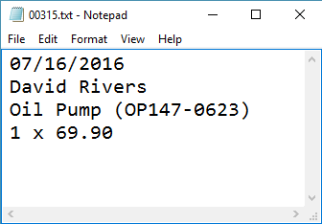
Storage vs. Management

Slide 10
Storage vs. Management (2)
Storing data is not the primary reason to use a Database
Flat storage eventually runs into issues with
Size
Ease of updating
Accuracy
Security
Redundancy
Importance

Slide 11


Database Engine

Slide 12





Database Engine Flow
SQL Server uses the Client-Server Model
Clients
Query
Engine
Access
Database
Data
Data

Slide 13
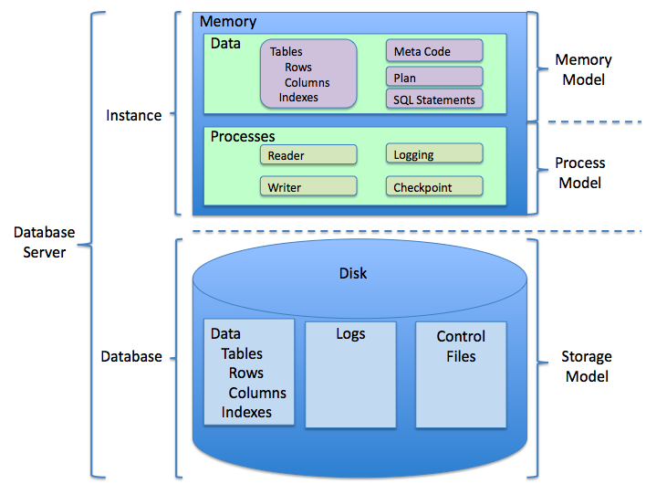

Slide 14
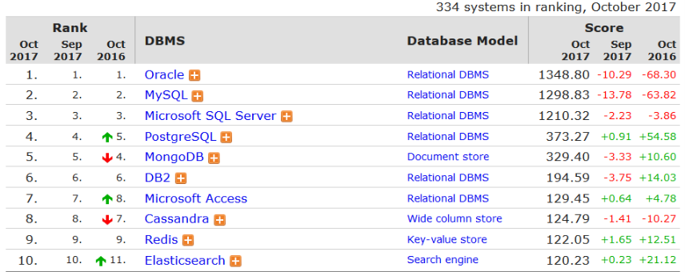
Top Database Engines
Source: http://db-engines.com/en/ranking

Slide 15
DataBase Types
Relational database (RDBMS)
Document-oriented database
Key-value database
TimeSeries
Triplestore
...many more

Slide 16
Databases and RDBMS
A database is an organized collection of information
It imposes rules on the contained data
Relational storage first proposed by Edgar Codd in 1970
A Relational Data Base Management System provides tools to manage the database
It parses requests from the user and takes the appropriate action
The user doesn't have direct access to the stored data

Slide 17

MySQL / MariaDB

Slide 18





Download Clients & Servers
Download XAMPP or Official MySQL Server or MariaDB Server
Download HeidiSQL, DataGrip or something else

Slide 19
MySQL Server Architecture
Logical Storage
Instance
Database/Schema
Table
Physical Storage
Data files and Log files
Data pages
Instance
Database
Database
Table
Table
Table
View
View
Database
Procedure
Data
Logs
☰
☰
☰
☰
☰
☰
☰
☰

Slide 20
Database Table Elements
The table is the main building block of any database
Each row is called a record or entity
Columns (fields) define the type of data they contain
Column
CustomerID | FirstName | Birthdate | CityID
1 | Brigitte | 03/12/1975 | 101
2 | August | 27/05/1968 | 102
3 | Benjamin | 15/10/1988 | 103
4 | Denis | 07/01/1993 | 104
Row
Cell
Notes:
The table is the main unit of data storage. It has rows, columns and cells. Cells contain stored data. Each column has a data type. Types can be VARCHAR(String), INT, DATE etc.

Slide 21
Data Types in MySQL Server

Slide 22
Basic Data Types in MySQL
Numeric
integer – different sizes
float, double, decimal – representing real numbers
Strings
char(size) – fixed size string
varchar(size) – variable size string
text,tinytext,mediumtext,longtext – text data block

Slide 23
Basic Data Types in MySQL (2)
Binary data
binary(size) – fixed binary byte strings
varbinary(size) – variable size binary byte strings
Date and time
date – range is '1000-01-01 to 9999-12-31'
datetime – range is '1000-01-01 00:00:00' to '9999-12-31 23:59:59'
timestamp – range of '1970-01-01 00:00:01' UTC to '2038-01-19 03:14:07' UTC.

Slide 24
Structured Query Language
To communicate with the Engine we use SQL
Declarative language
Logically divided in four sections
Data Definition – describe the structure of our data
Data Manipulation – store and retrieve data
Data Control – define who can access the data
Transaction Control – bundle operations and allow rollback

Slide 25


Database Modeling
Data Definition using HeidiSQL

Slide 26
Working with HeidiSQL
HeidiSQL is a tool that helps us when working with the database and its objects
Enables us:
To create a new database
To create objects in the database (tables, stored procedures, relationships and others)
To change the properties of objects
To enter records into the tables

Slide 27
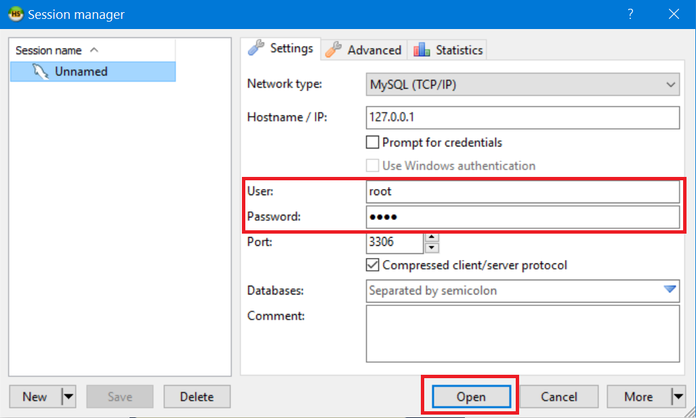
Make New Connection
Connect to MySQL Server with user root and the password you set up

Slide 28
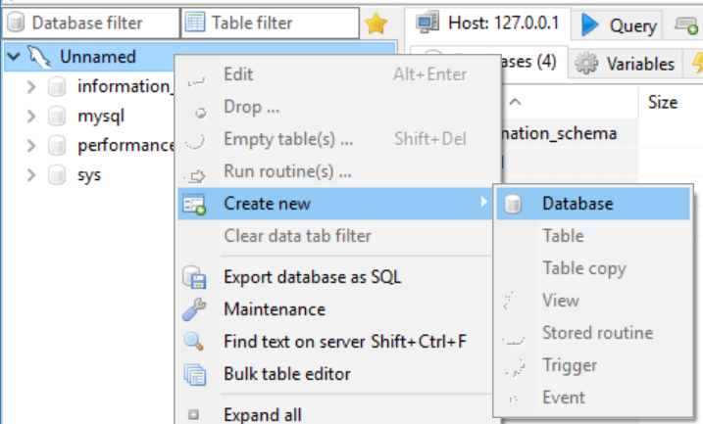
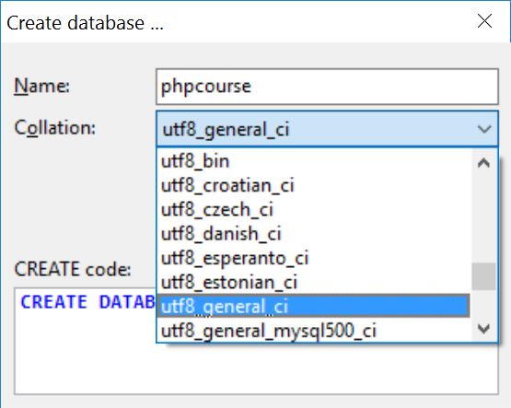
Creating a New Database
Select Create new -> Database from the context menu
Encoding

Slide 29
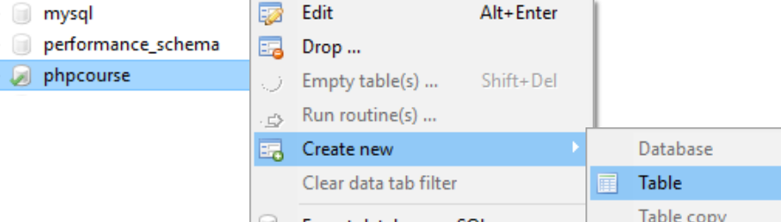
Creating Tables
From the context menu under Create new -> Table inside the desired database

Slide 30
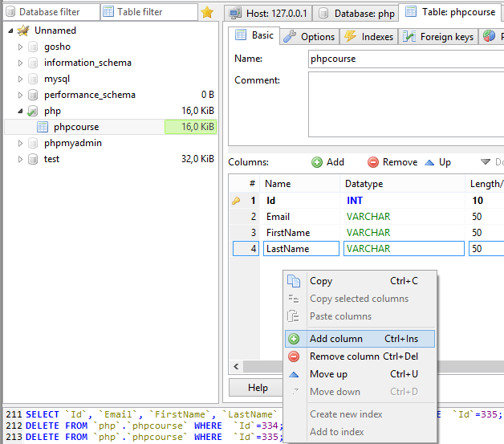
Creating Tables (2)
To add a field use Add column

Slide 31
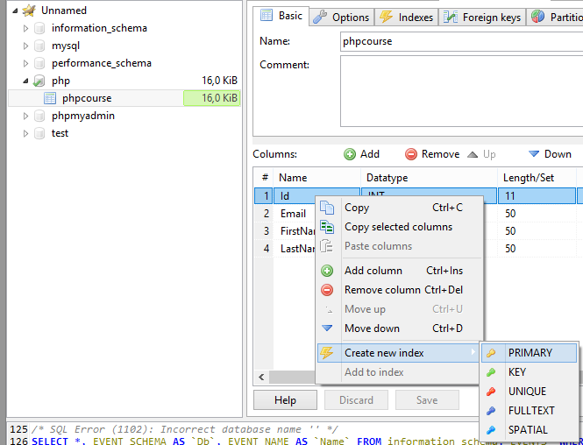
Creating Tables (3)
A Primary Key is used to uniquely identify and index records
Click PRIMARY from the context menu of the desired field

Slide 32
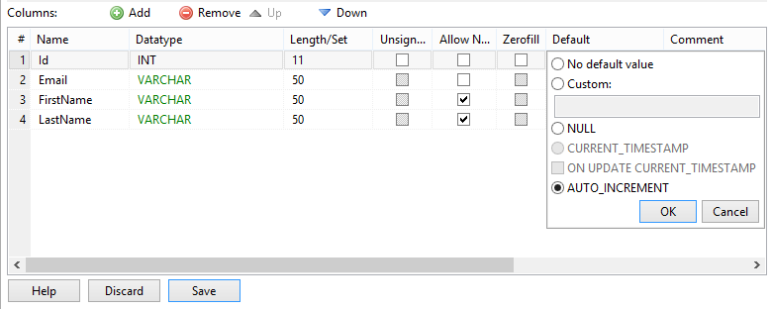
Field Defaults
You can set a default value for every field
No default value makes the field mandatory on row insert

Slide 33
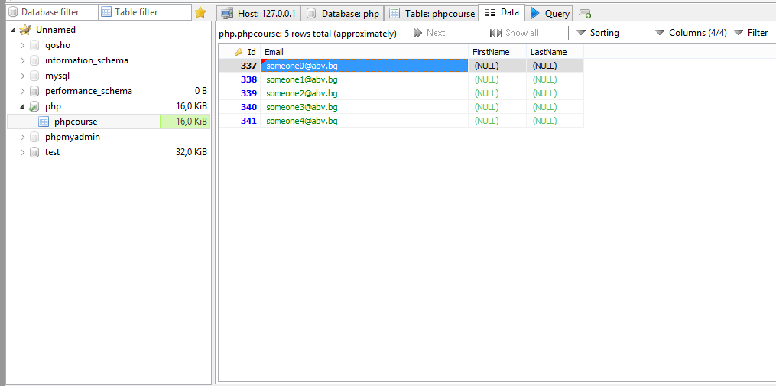
Manipulate Data
For all kinds of data manipulations select the Data tab

Slide 34
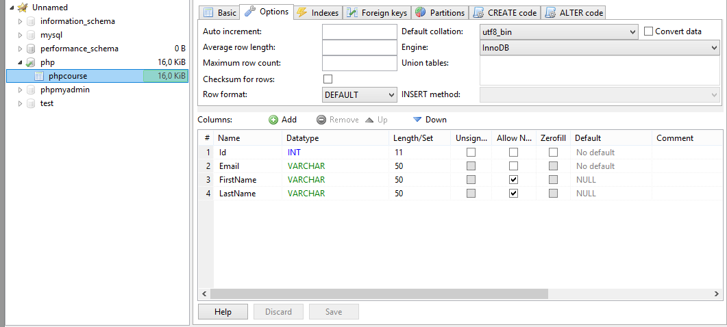
Altering Tables
You can change the properties of a table after its creation

Slide 35
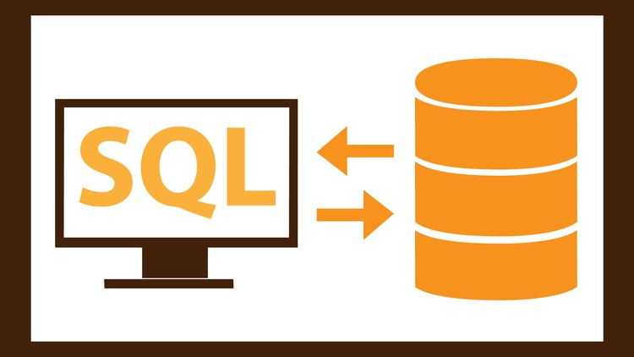
Basic SQL Queries

Slide 36
SQL Queries
We can communicate with the database engine using SQL
Queries provide greater control and flexibility
To create a database using SQL:
SQL keywords are traditionally capitalized
Database name
CREATE DATABASE People

Slide 37
Table Creation in SQL
Table name
CREATE TABLE Employees
(
Id int NOT NULL,
Email varchar(50) NOT NULL,
FirstName varchar(50),
LastName varchar(50)
)
Custom properties
Column name
Data type

Slide 38
Retrieve Records in SQL
To get all information from a table
You can limit the columns and number of records
Table name
SELECT * FROM Employees
Number of records
List of columns
SELECT FirstName, LastName
FROM Employees
LIMIT 5

Slide 39
Deleting from Database
Deleting structures
You can drop keys, constraints, tables and entire databases
Deleting all data in a table
Both of these actions cannot be undone – use with caution!

Slide 40
Dropping, Deleting and Truncating
Table name
To delete all the entries in a table
To drop a table – delete data and structure
To drop entire database
DELETE FROM Employees
TRUNCATE TABLE Employees
DROP TABLE Employees
Table name
Database name
DROP DATABASE People

Slide 41

Summary
RDBMS store and manage data
MySQL server also stores data types
Modeling database
Using tools like HeidiSQL
Execute basic SQL Queries

Slide 42








MySQL Introduction
https://softuni.bg/courses/php-basics/

Slide 43

License
This course (slides, examples, demos, videos, homework, etc.) is licensed under the "Creative Commons Attribution-NonCommercial-ShareAlike 4.0 International" license
Attribution: this work may contain portions from
"PHP Manual" by The PHP Group under CC-BY license
"PHP and MySQL Web Development" course by Telerik Academy under CC-BY-NC-SA license

Slide 44




Free Trainings @ Software University
Software University Foundation – softuni.org
Software University – High-Quality Education, Profession and Job for Software Developers
softuni.bg
Software University @ Facebook
facebook.com/SoftwareUniversity
Software University Forums
forum.softuni.bg

